Slide 1
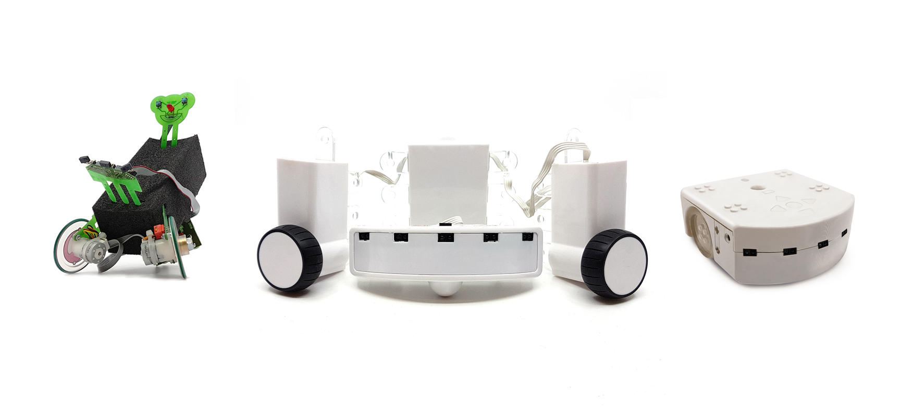
Web simulation of a Thymio robot
Bachelor Thesis
Flückiger Quentin

Slide 2

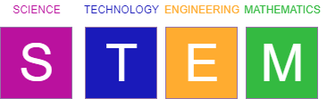


Thymio
Notes:
Talk about what thymio is,
Promote stem among children,
It is used in school activities (in Bienne in a primary school they use it)

Slide 3
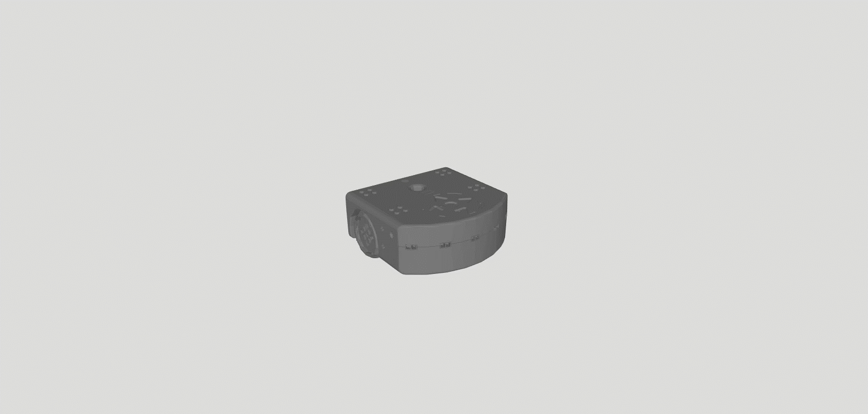
Thymio II model
Notes:
3D model

Slide 4
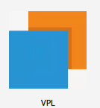
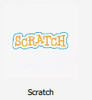

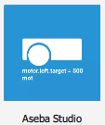
Four possible programming languages
Notes:
VPL, which gets name from what it stands for visual programming language, Even if this variant is used only for Thymio. It uses blocks, there exist mainly two kind of blocks the event and the actions. Easy to understand
Scratch, which is a vpl from the MIT with customized block. LEGO LIKE
Blockly or blockly4thymio, is based on the blockly from google which is a js library for building vp editors, the code can be compiled into 5 languages. LEGO LIKE
And aseba studio only textual programming language
All are saved as .aesl files
Can be programmed using thymio suite

Slide 5
Content
Goals
Technologies used
Actuator
Sensor
Compiler
Built-in behavior
Customized playground
Conclusion

Slide 6
Goals
Web Simulation of a Thymio robot
3D view of the robot and its environment
Actuator / Sensor simulation
No installation required
Compatible with modern browsers
Notes:
But what where actually my goals ?
The main goal was to create a simulation environment for the thymio robot

Slide 7
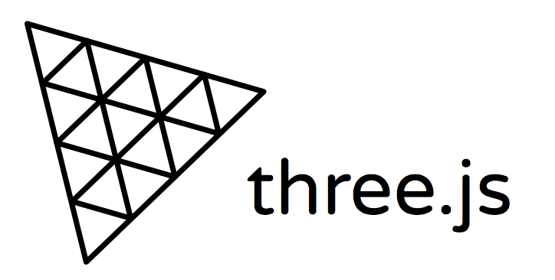

Technologies used
Notes:
WebGL javascript library
It is compatible with modern browsers
No client side installation required
Xampp to host webserver

Slide 8
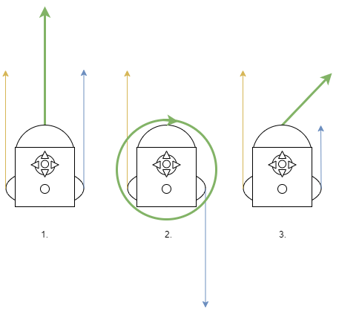
Actuator
Motors

Slide 9
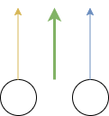
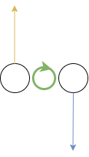
Actuator
Motors
1
2

Slide 10
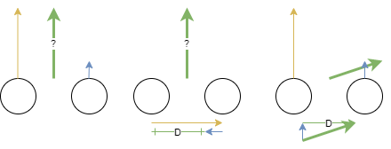
Actuator
Motors
3

Slide 11
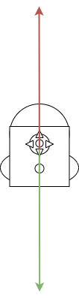
Sensor
Proximity
Raycast technology
Notes:
Raycaster
Intersection with elements
See later that the clipping, need more ray from multiple positions

Slide 12
Compiler
Compile .aesl file into bytecode
Translate C++ to JavaScript
Multiple steps for the compiler

Slide 13
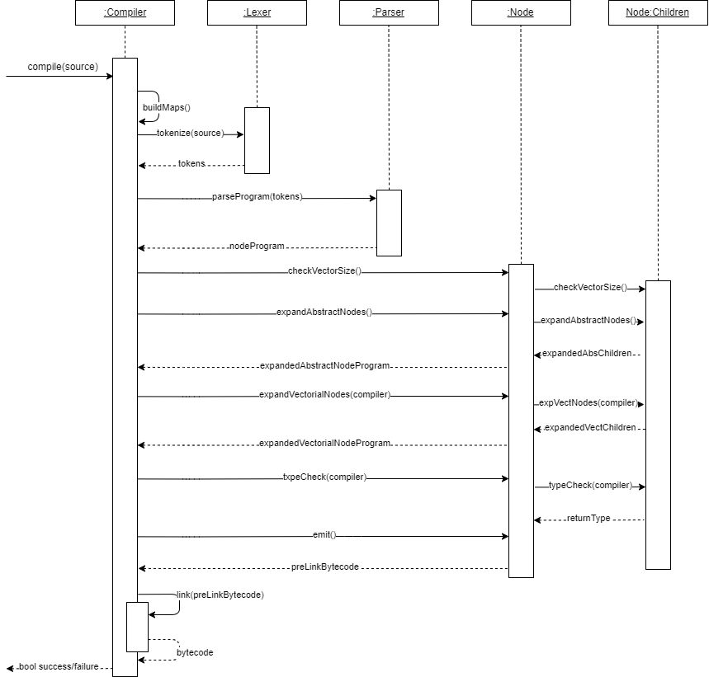

Slide 14
Compiler
Compile .aesl file into bytecode
Translate C++ to JavaScript
Multiple steps for the compiler
Tokenization
Parsing
Expanding
Optimization
Linking
Notes:
Skim the file and tokenize it, position value and type
Some need multiple characters look ahead (when) some are fine with juste 1 (,)
Parse, create a tree with node element of right type depending on the token or the chain of tokens

Slide 15
Built-in Behaviors
Basic state

Slide 16
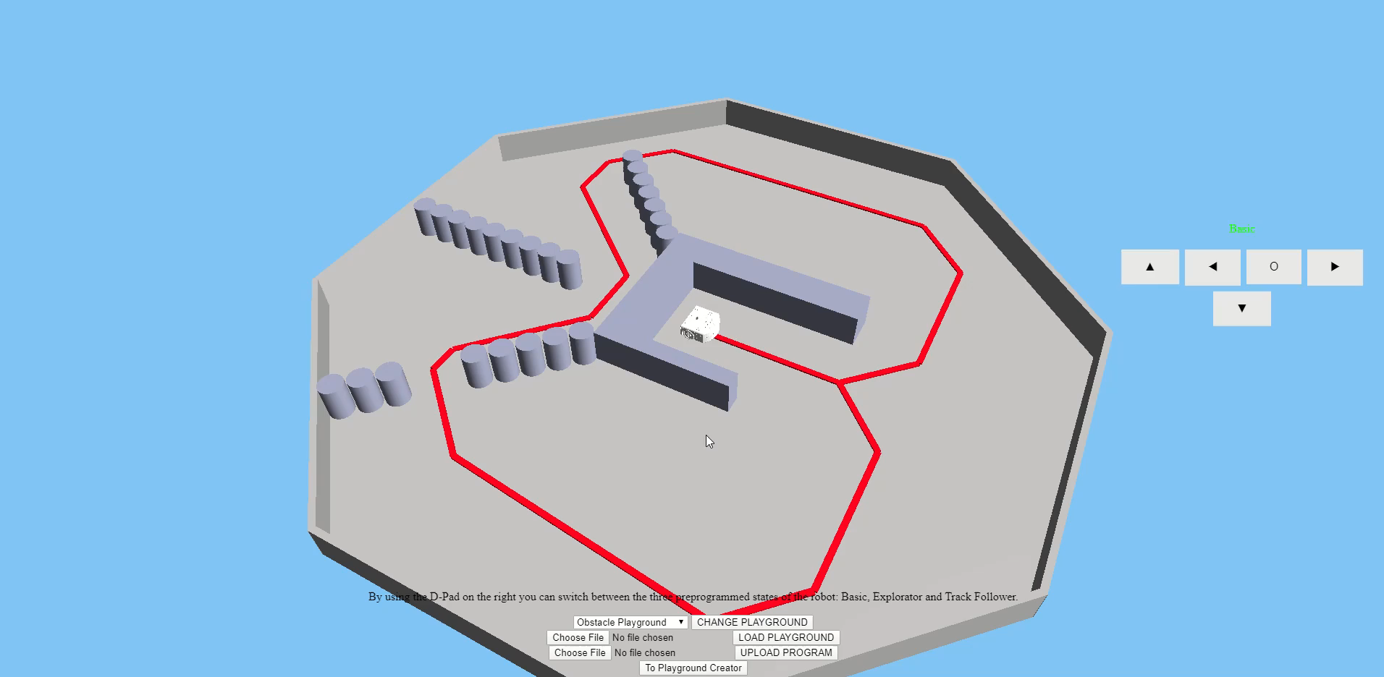
Built-in Behaviors
Basic state
Basic state

Slide 17
Built-in Behaviors
Basic state
Explorer state

Slide 18
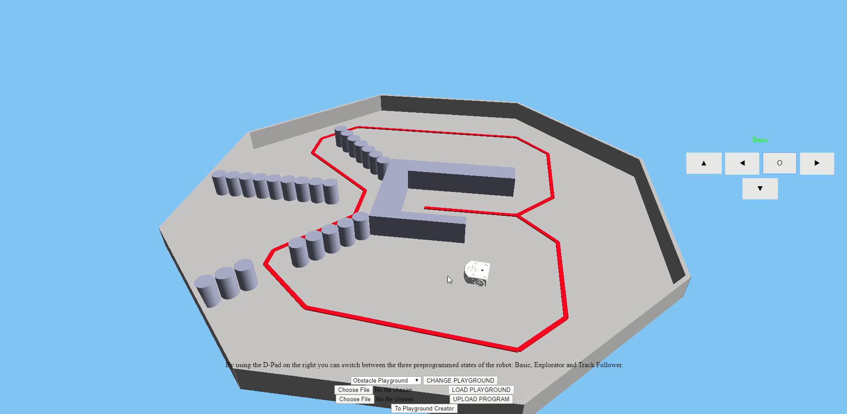
Built-in Behaviors
Explorer state
Basic state
Explorer state

Slide 19
Built-in Behaviors
Basic state
Explorer state
Track follower state

Slide 20
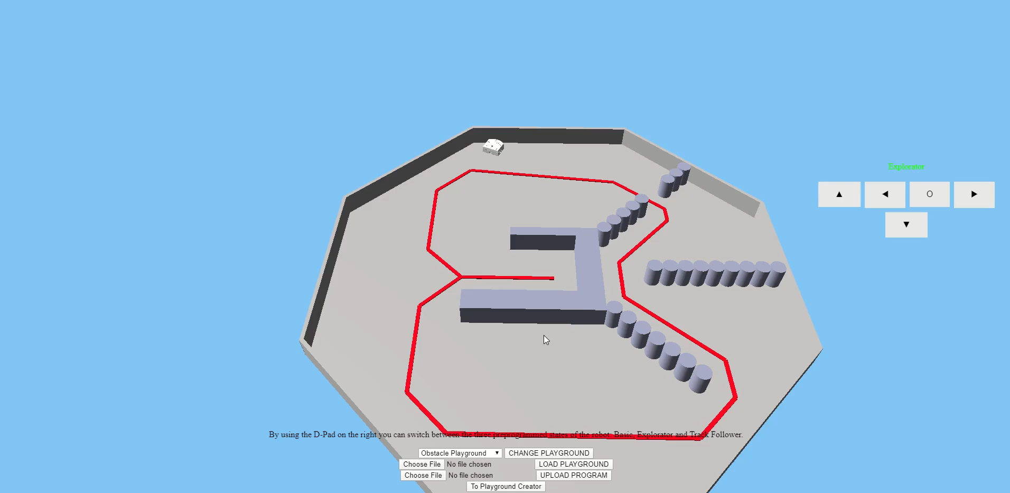
Built-in Behaviors
Track follower state
Basic state
Explorer state
Track follower state

Slide 21
Customized playground
Multiple Shapes
Ghost preview of shapes
Ctrl-Z / Ctrl-Y
Saves playground as JSON file
Load them in Simulator
Notes:
Allows ………

Slide 22
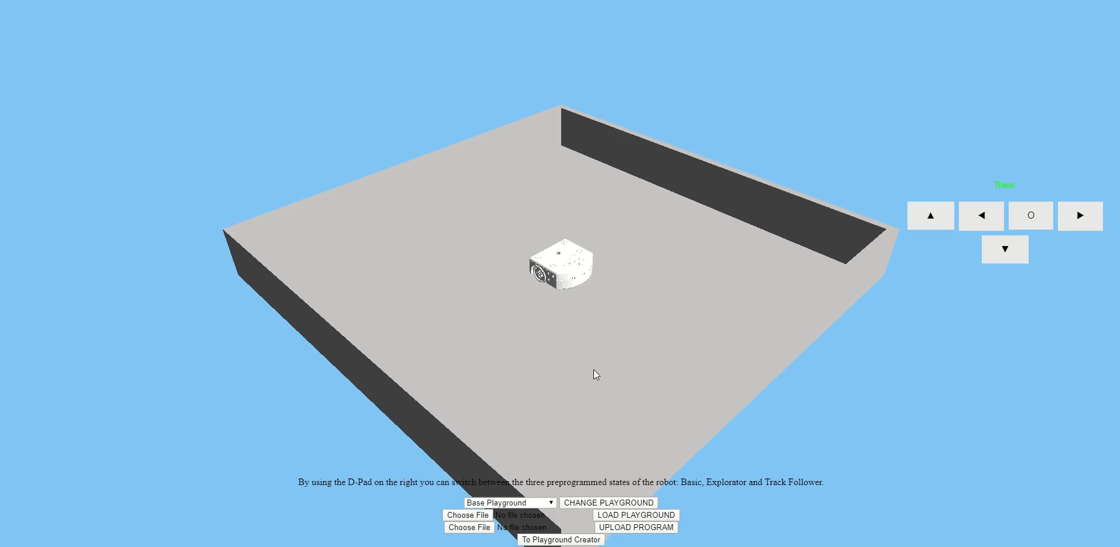
Customized playground

Slide 23
Conclusion
A working 3D environment and creation tool
Thymio base behavior
Sensor and actuator simulation
Require more work for .aesl file as behavior file, but possible
Notes:
3D env, can be easily enhanced with more shapes thanks to our architecture
The built-in behaviors can be enhanced with a shape following, or controlling the robot with the sound with new sensor.

Slide 24
Question(s) ?
Notes:
Thank you for your time and attention

Slide 25
Sources
1. https://www.thymio.org/about/
2. https://medium.com/javascript-in-plain-english/developing-3d-web-apps-with-three-js-c5f7468f3114
3. http://logosolusa.com/xampp-logo.html

